Slide 1
SIR Model

Slide 2
What is a Pandemic?
Epidemic a rapid spread of disease to a large number of hosts within a short period of time.
Pandemic is an epidemic of an infectious disease spreading across a large region (multiple continents or worldwide).
For centuries, pandemics have been considered major challenges to human progress and survival.
The Black Death (“The Plague”), Fourteenth century
The influenza pandemic, 1918–1920
AIDS, 1981
SARS, 2003

Slide 3
Why Model?
People have performed many studies to better understand and control the spread of epidemics.
The epidemic dynamical models have been used to study the behavior of epidemics widely:
Estimating disease transmission, recovery and deaths
Planning strategies to control the spread of the disease

Slide 4
COVID-19
In December 2019, a novel strand of Coronavirus (SARS-CoV-2) was identified in Wuhan, China
The virus was causing a severe and potentially fatal respiratory syndrome, i.e., COVID-19.
Since then, it has spread around the globe and became a public health threat.
On March 11, it was declared a pandemic by World Health Organization (WHO).

Slide 5
Mathematical models have been helpful to predict the possibility and severity of the outbreak.
They have provided key information to determine the intensity of COVID-19 disease intervention.
The SIR model and its extended modifications have been used to model the spread of COVID-19 within communities.

Slide 6






So, what is SIR Model?
SIR is short for “Susceptible-Infected-Removed”
Susceptible (S): Individuals who have not been infected, vulnerable.
Infected (I): Individuals who are infected and can transmit to the susceptibles.
Removed (R): Individuals who have recovered, have been isolated or died from the disease.
Notes:
Susceptible (S): Vulnerable individuals who are not infected but may become infected, or remain susceptible.
Infected (I): Individuals who have already been infected and can transmit to the susceptible individuals. An infected individual may be removed, or remain infected.
Removed (R): Individuals who have recovered from the virus and are assumed to be immune, or have died from the disease.

Slide 7
Last Important Definitions
Infection Rate (a)
Also known as the transmission rate.
The rate in which Susceptible individuals become Infected.
Recovery Rate (r)
The rate in which Infected individuals become Removed.
a, r are both positive parameters.
Notes:
Infection rate - average number of contacts per person per time, multiplied by the probability of disease transmission in a contact between a susceptible and an infectious subject.
Proportional to the number of contacts between susceptible and infective individuals
Recovery rate - the probability of an infected individual to recover at time t.

Slide 8
Assumptions
In our model, we will assume:
Total population remains constant
Infection Rate is constant and denoted by a
Recovery Rate is constant and denoted by r
Notes:
Infection rate - average number of contacts per person per time, multiplied by the probability of disease transmission in a contact between a susceptible and an infectious subject.

Slide 9
Notations
We will denote the total population as N.
As we previously assumed, N remains constant throughout the pandemic.
N = Susceptible + Infected + Removed

Slide 10
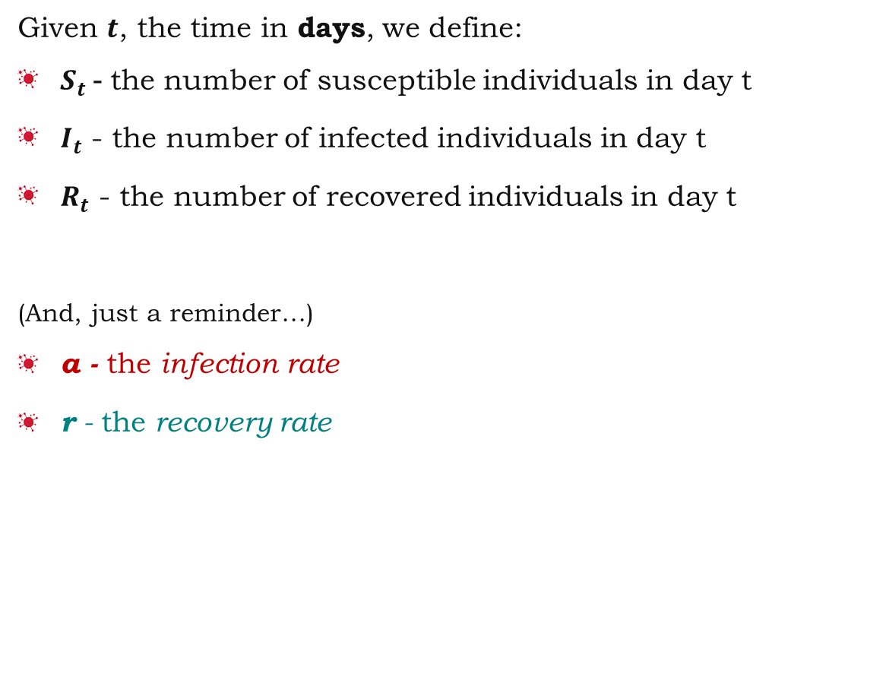
Notations
Given $t$, the time in days, we define:
$S_{t}$- the number of susceptible individuals in day t
$I_{t}$ - the number of infected individuals in day t
$R_{t}$ - the number of recovered individuals in day t
(And, just a reminder…)
a - the infection rate
r - the recovery rate
Notes:
Infection rate - average number of contacts per person per time, multiplied by the probability of disease transmission in a contact between a susceptible and an infectious subject.

Slide 11


SIR Model Equations
We can now conclude the differences in the numbers of susceptibles, infected and removed
from day $t$ to day $t+1:$
$$S_{t+1}−S_{t}=−aS_{t}I_{t}$$
$$I_{t+1}−I_{t}=aS_{t}I_{t}−rI_{t}$$
$$R_{t+1}−R_{t}=rI_{t}$$
Notes:
Infection rate - average number of contacts per person per time, multiplied by the probability of disease transmission in a contact between a susceptible and an infectious subject.

Slide 12

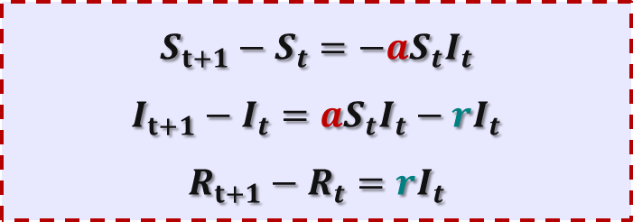
SIR Model Equations
$$S_{t+1}−S_{t}=−aS_{t}I_{t}$$
$$I_{t+1}−I_{t}=aS_{t}I_{t}−rI_{t}$$
$$R_{t+1}−R_{t}=rI_{t}$$
Initial values $(t=0)$:
$${S(0)=S}_{0}$$
$${I(0)=I}_{0}$$
We assume:
$$R(0)=0$$
Therefore, $N_{0}=S_{0}+I_{0}$
And from our 1st assumption ($∀t. N_{t}=N_{0}$) we get:
$$∀t. N_{t}=S_{t}+I_{t}+R_{t}=S_{0}+I_{0}=N_{0}$$

Slide 13
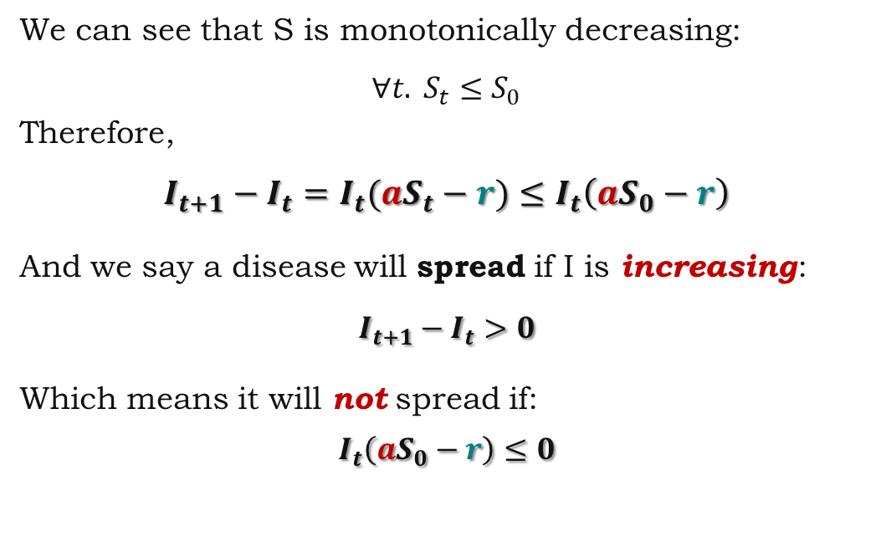
Will the disease spread?
$$S_{t+1}−S_{t}=−aS_{t}I_{t}$$
$$I_{t+1}−I_{t}=aS_{t}I_{t}−rI_{t}$$
$$R_{t+1}−R_{t}=rI_{t}$$
We can see that S is monotonically decreasing:
$$∀t. S_{t}≤S_{0}$$
Therefore,
$$I_{t+1}−I_{t}=I_{t}(aS_{t}−r)≤I_{t}\left(aS_{0}−r\right)$$
And we say a disease will spread if I is increasing:
$$I_{t+1}−I_{t}>0$$
Which means it will not spread if:
$$I_{t}\left(aS_{0}−r\right)≤0$$

Slide 14



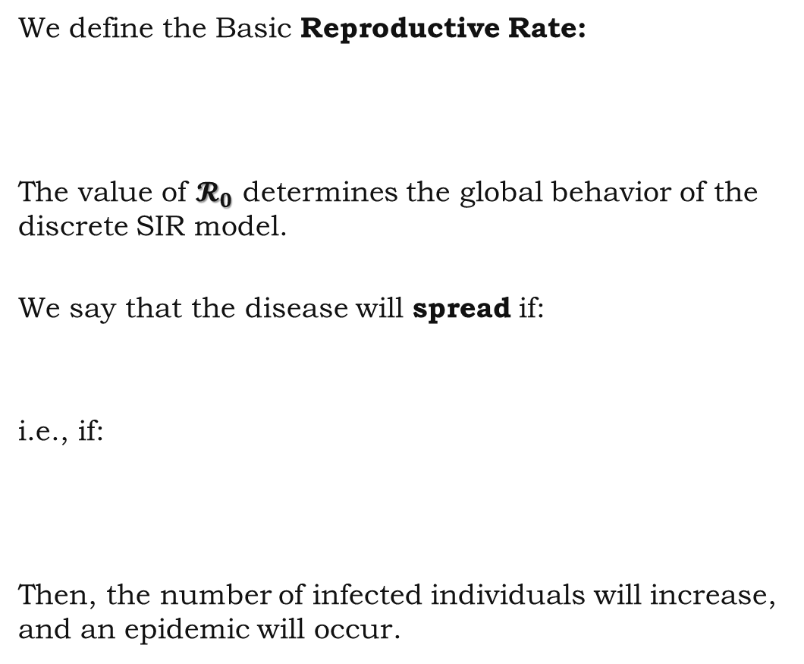
Reproduction Rate
We define the Basic Reproductive Rate:
The value of $𝓡_{0}$ determines the global behavior of the discrete SIR model.
We say that the disease will spread if:
i.e., if:
Then, the number of infected individuals will increase, and an epidemic will occur.
$𝓡_{0}=\frac{a}{r}$ $S_{0}$
$$𝓡_{0}>1$$
$$S_{0}>\frac{r}{a}$$
Notes:
Reproductive Rate - the average number of secondary infections caused by one initially infected individual,
i.e., if one person has the disease, it tells us how many infections in average this person will cause (how many other people they will transmit the disease to within the population).
$$q=\frac{a}{r}$$
q is the contact ratio: the fraction of the population that encounters an infective individual during the period they are infectious.

Slide 15
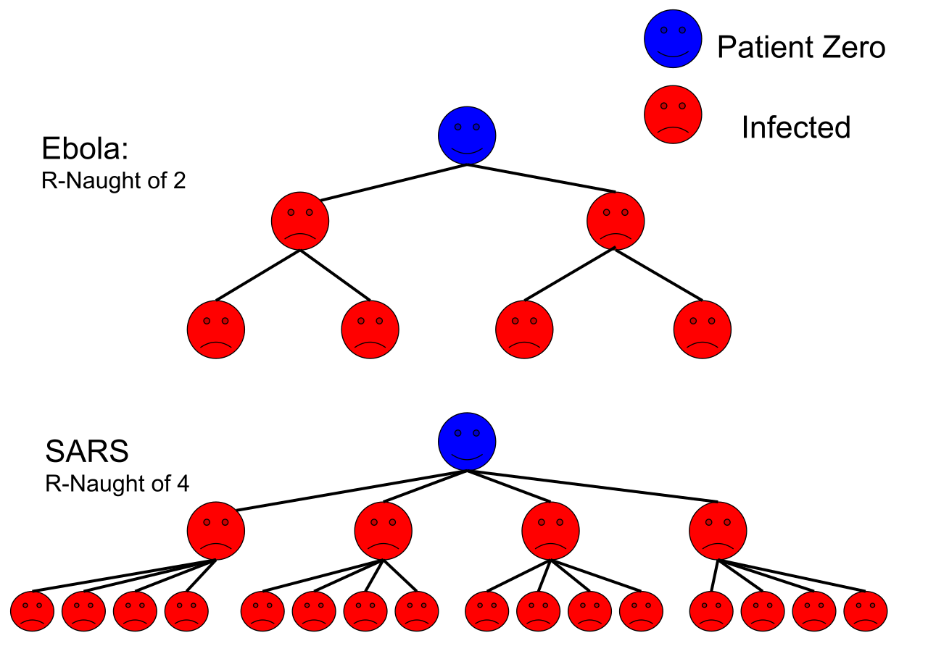
Reproduction Rate
Notes:
Reproductive Rate - the average number of secondary infections caused by one initially infected individual,

Slide 16
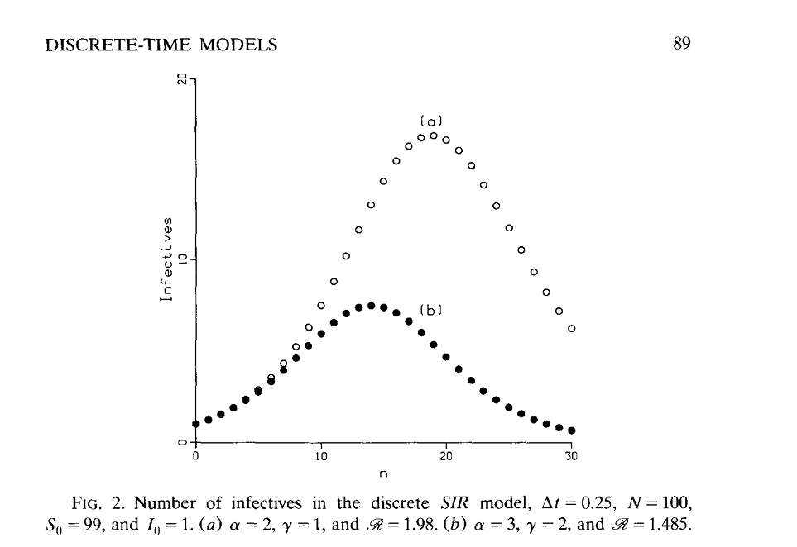
Reproduction Rate
“Some discrete-time SI, SIR, and SIS epidemic models”
by George King

Slide 17
Illustration

Slide 18
Herd Immunity
Indirect protection from infectious disease.
Can occur when a sufficient percentage of a population has become immune to an infection.
The greater the proportion of immune individuals, the smaller the probability that susceptible individuals will encounter infectious individuals.
Defined as the point where the disease reaches an endemic steady state; the infection level is neither growing nor declining exponentially.

Slide 19


Herd Immunity Threshold
Let’s define:
$p −the fraction of the population that is immune to the disease$
$$\frac{S}{N}=1−p$$
The critical value for herd immunity is given by:
$$𝓡_{0}⋅\frac{S}{N}=1$$
i.e.,
$$ℛ_{0}⋅\left(1−p\right)=1$$
$$p_{c}=1−\frac{1}{𝓡_{0}}$$
Notes:
highly connected networks transmit disease more easily, resulting in a higher R₀ and a higher HIT than would be required in a less connected network

Slide 20
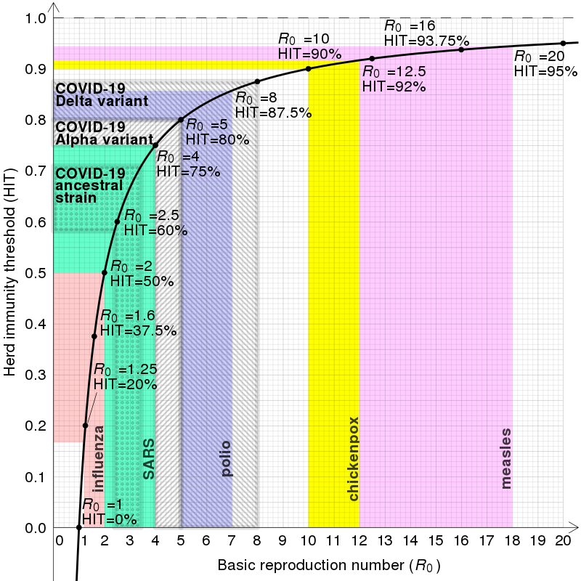
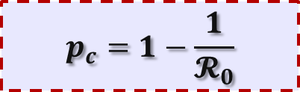
Herd Immunity
$$p_{c}=1−\frac{1}{𝓡_{0}}$$
Notes:
highly connected networks transmit disease more easily, resulting in a higher R₀ and a higher HIT than would be required in a less connected network

Slide 21
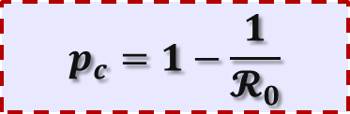
Herd Immunity
$$p_{c}=1−\frac{1}{𝓡_{0}}$$
Values of R0 and herd immunity thresholds (HITs) of well-known infectious diseases
Disease | Transmission | R₀ | HIT
Measles | Aerosol | 12–18^{[55][56]} | 92–94%
Chickenpox (varicella) | Aerosol | 10–12^{[57]} | 90–92%
Mumps | Respiratory droplets | 10–12^{[58]} | 90–92%
Rubella | Respiratory droplets | 6–7^{[b]} | 83–86%
Polio | Fecal–oral route | 5–7^{[b]} | 80–86%
Pertussis | Respiratory droplets | 5.5^{[63]} | 82%
COVID-19 (Delta variant) | Respiratory droplets and aerosol | 5.1 | 80%
Smallpox | Respiratory droplets | 3.5–6.0^{[65]} | 71–83%
COVID-19 (Alpha variant) | Respiratory droplets and aerosol | 4–5^{[66][medical citation needed]} | 75–80%
HIV/AIDS | Body fluids | 2–5^{[67]} | 50–80%
COVID-19 (ancestral strain) | Respiratory droplets and aerosol^{[68]} | 2.9 (2.4–3.4)^{[69]} | 65% (58–71%)
SARS | Respiratory droplets | 2–4^{[70]} | 50–75%
Diphtheria | Saliva | 2.6 (1.7–4.3)^{[71]} | 62% (41–77%)
Common cold | Respiratory droplets | 2–3^{[72][medical citation needed]} | 50–67%
Influenza (1918 pandemic strain) | Respiratory droplets | 2^{[73]} | 50%
Ebola (2014 outbreak) | Body fluids | 1.8 (1.4–1.8)^{[74]} | 44% (31–44%)
Influenza (2009 pandemic strain) | Respiratory droplets | 1.6 (1.3–2.0)^{[75]} | 37% (25–51%)
Influenza (seasonal strains) | Respiratory droplets | 1.3 (1.2–1.4)^{[76]} | 23% (17–29%)
Andes hantavirus | Respiratory droplets and body fluids | 1.2 (0.8–1.6)^{[77]} | 16% (0–36%)^{[c]}
Nipah virus | Body fluids | 0.5^{[78]} | 0%^{[c]}
MERS | Respiratory droplets | 0.5 (0.3–0.8)^{[79]} | 0%^{[c]}
Notes:
Infection rate - average number of contacts per person per time, multiplied by the probability of disease transmission in a contact between a susceptible and an infectious subject.

Slide 22
Let’s go back to the illustration

Slide 23

How many will get infected?
$$S_{t+1}−S_{t}=−aS_{t}I_{t}$$
$$I_{t+1}−I_{t}=aS_{t}I_{t}−rI_{t}$$
$$R_{t+1}−R_{t}=rI_{t}$$
Recall our assumption:
$$∀t. N_{t}=S_{t}+I_{t}+R_{t}=S_{0}+I_{0}=N_{0}$$
Denote the end of the epidemic by time T.
$$I_{T}=0$$
So, from our assumption about the total population, we get:
$${S_{0}+I_{0}=S}_{T}+R_{T}$$
$$→{ R}_{T} ={S_{0}+I_{0}−S}_{T}$$
Notes:
Infection rate - average number of contacts per person per time, multiplied by the probability of disease transmission in a contact between a susceptible and an infectious subject.

Slide 24
Extensions to SIR Model
SEIR Model

Slide 25
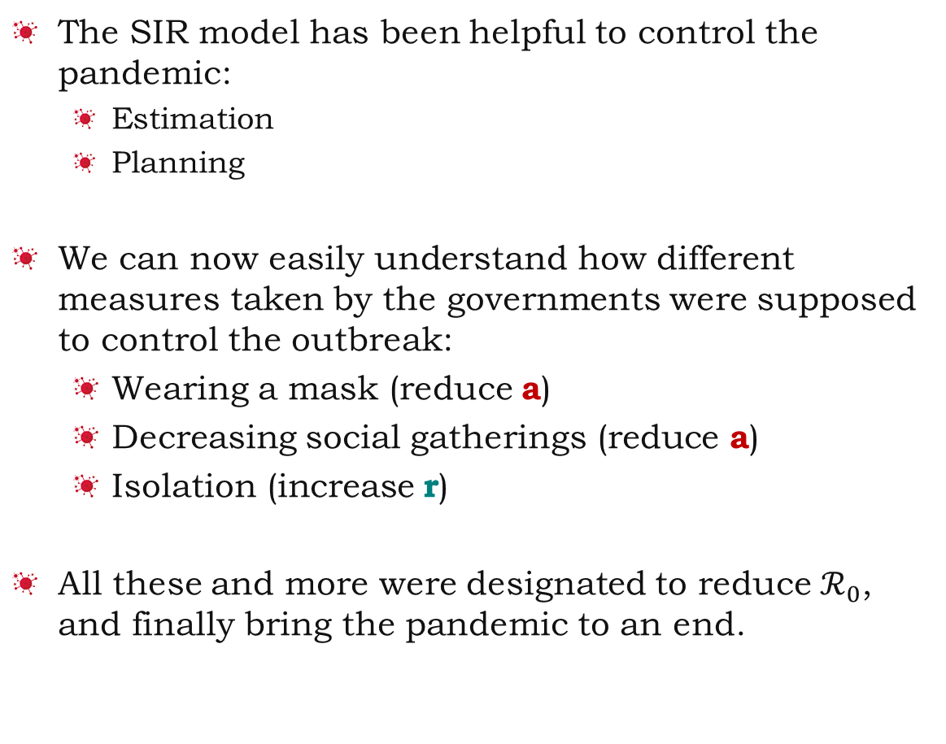
Summary
The SIR model has been helpful to control the pandemic:
Estimation
Planning
We can now easily understand how different measures taken by the governments were supposed to control the outbreak:
Wearing a mask (reduce a)
Decreasing social gatherings (reduce a)
Isolation (increase r)
All these and more were designated to reduce $ℛ_{0}$, and finally bring the pandemic to an end.

Slide 26
References
“A discrete SIR infectious disease model”
Math Insight
Link
“Stability and bifurcation analysis in a discrete SIR epidemic model”
Link
“Some discrete-time SI, SIR, and SIS epidemic models”
By George King
“A SIR model assumption for the spread of COVID-19 in different communities”
By Ian Cooper, Argha Mondal, and Chris G. Antonopoulos
Link

